Slide 1


Introduction to Sequence Alignment
Sequence alignment is the process of arranging DNA, RNA, or protein sequences to identify similarities and differences. It plays a crucial role in genetics and molecular biology.
Pairwise sequence alignment compares two sequences, uncovering evolutionary relationships and functional similarities. It is essential for understanding genetic variations and protein structures.

Slide 2

Importance of Sequence Alignment in Bioinformatics
Genetic Analysis
Drug Discovery
Sequence alignment is crucial for comparing genetic sequences to understand evolutionary relationships.
Enables identification of conserved regions in sequences, aiding in drug target discovery.
Disease Research
Helps in identifying mutations and understanding genetic causes of diseases.

Slide 3

Pairwise Sequence Alignment: Definition and Purpose
Definition: A method to align two sequences to identify similarities and differences.
Purpose: Allows for comparison of DNA, RNA, or protein sequences to infer evolutionary relationships.
Significance: Essential for understanding genetic mutations and functional conservation in biological research.

Slide 4

Methods for Pairwise Sequence Alignment
1
Needleman-Wunsch
An algorithm for global sequence alignment with affine gap penalties.
2
Smith-Waterman
Used for local sequence alignment to identify regions of similarity.
3
BLAST
A popular heuristic method for searching similar sequences in databases.

Slide 5
TOOLS for Pairwise Sequence Alignment
EMBOSS Needle
1
A tool from the EMBOSS suite, Needle performs global pairwise sequence alignments using the Needleman-Wunsch algorithm.
2
EMBOSS Water
Also part of the EMBOSS suite, Water performs local pairwise
sequence alignments using the Smith-Waterman algorithm.

Slide 6
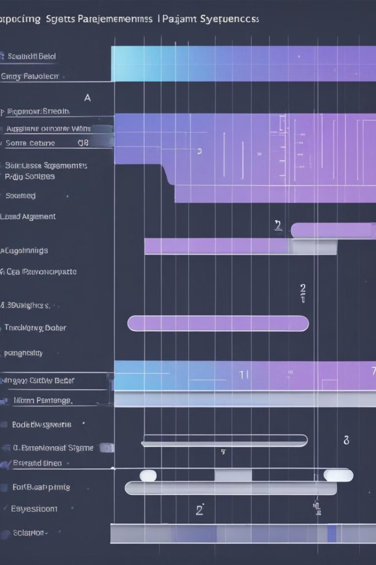
Scoring Systems and Gap Penalties in Pairwise Sequence Alignment
Scoring systems in pairwise sequence alignment determine the match, mismatch, and gap scores, crucial for assessing similarity between sequences.
Gap penalties control the cost of introducing gaps, influencing the alignment quality and determining the significance of gaps in sequences.

Slide 7
Applications of Pairwise Sequence Alignment in Biological Research
Pairwise sequence alignment is extensively used in biological research for comparing DNA, RNA, or protein sequences.
It assists in identifying homologous sequences, exploring evolutionary relationships, and annotating new genes or proteins.
The alignment results aid in predicting protein structure and function, understanding mutations, and designing experiments for genetic studies.

Slide 8
Limitations and challenges of pairwise sequence alignment
Algorithm complexity
1
Increased computation time
Scoring system selection
2
Choosing appropriate scoring matrices
Gap penalties
3
Optimizing for best gap placement
Sequence length
4
Difficulty in aligning very long sequences

Slide 9
Comparison of Pairwise Sequence Alignment with Multiple Sequence Alignment
Pairwise Sequence Alignment
Multiple Sequence Alignment
Compares two sequences to find the best matching pairs.
Aligns three or more sequences to identify conserved regions.
Useful for aligning sequences from the same or closely related species.
Appropriate for comparing sequences from divergent species.

Slide 10




Future Developments and Trends in Pairwise Sequence Alignment
Enhanced Algorithms
Integration of Machine Learning
Automated Alignment Tools
Enhanced Visualization Techniques
Advanced algorithms optimizing speed and accuracy in alignment.
Utilizing machine learning for improved sequence comparison.
Development of automated tools for rapid sequence alignment.
Improved visualization methods for better interpretation of alignments.

Slide 11
Conclusion: the significance of accurate sequence alignment for understanding genetic relationships
Genetic Relationships
Biological Insights
Accurate sequence alignment allows for the comparison of genetic material, aiding in the understanding of evolutionary relationships and genetic variation.
It provides crucial insights into the similarities and differences between species, contributing to the study of evolutionary biology and species divergence.
Medical Applications
Future Research
Facilitates the identification of genetic markers and variations associated with diseases, enabling advancements in personalized medicine and targeted therapies.
Continuous advancements in accurate sequence alignment will drive new discoveries in genomics, evolutionary biology, and medical research.

